Slide 1
WAVES
Energy
Transverse Wave
Energy
Longitudinal Wave

Slide 2
Waves
Transverse Wave: The waves in which the particles of the medium oscillate perpendicular to the waves direction of travel are called transverse waves.
Longitudinal Waves: The waves in which the particles of the medium oscillate parallel to the waves direction of travel are called longitudinal waves.

Slide 3



Equation of Transverse Travelling Wave
y
$$y_{m}$$
x
Equation for transverse travelling wave moving in +ve x-axis,
$$y\left(x,t\right)=y_{m}\sin{(kx−ωt)}$$
Equation for transverse travelling wave moving in -ve x-axis,
$$y\left(x,t\right)=y_{m}\sin{(kx+ωt)}$$

Slide 4
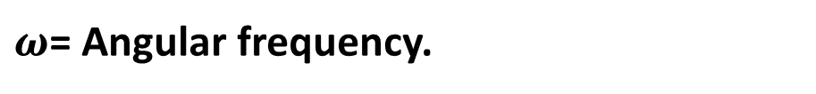
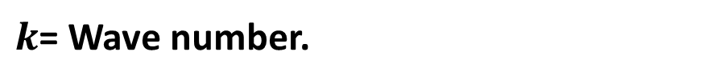
$y_{m}$= Amplitude of the wave which is always positive.
$(kx−ωt)$= Phase of the wave which is a constant.
$k$= Wave number.
$ω$= Angular frequency.

Slide 5
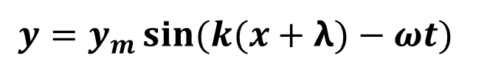


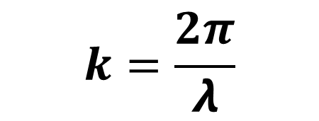




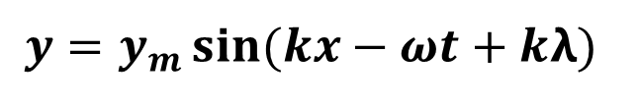
$$k=\frac{2π}{λ}$$
$$(kx−ωt)$$
($kx−ωt+kλ$)
y
$$y$$
$$y$$
x
$$x$$
$(x$+𝝺)
We have, $y=y_{m}\sin{(kx−ωt)}$
$$y=y_{m}\sin{(k(x+λ)−ωt)}$$
$$y=y_{m}\sin{(kx−ωt+kλ)}$$

Slide 6
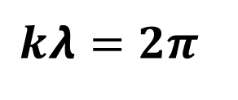
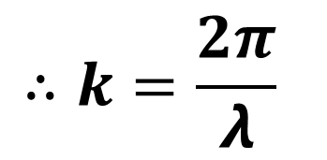
As a sine function repeats itself after each 2$π$radian, so
$$kλ=2π$$
$$∴k=\frac{2π}{λ}$$

Slide 7




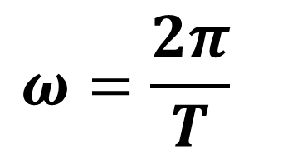
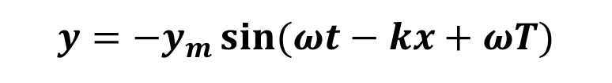


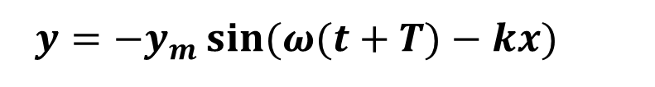

$$ω=\frac{2π}{T}$$
$$(ωt−kx)$$
$$(ωt−kx+ωT)$$
y
$$y$$
$$y$$
x
$$t$$
$$(t+T)$$
We have, $y=y_{m}\sin{(kx−ωt)}$
$$y={−y}_{m}\sin{(ωt−kx)}$$
$y={−y}_{m}\sin{(ω(t+T)−kx)}$
$$y={−y}_{m}\sin{(ωt−kx+ωT)}$$

Slide 8
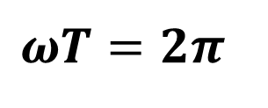

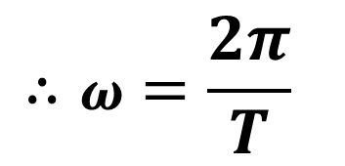
As a sine function repeats itself after each 2$π$radian, so
$$ωT=2π$$
$$∴ω=\frac{2π}{T}$$

Slide 9

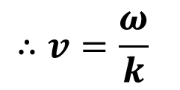
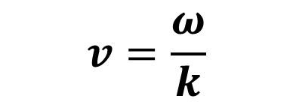
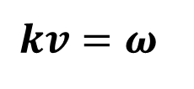
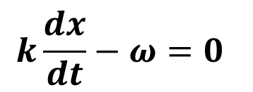

$$v=\frac{ω}{k}$$
The equation of transverse travelling wave moving in +ve x-axis is,
$$y=y_{m}\sin{(kx−ωt)}$$
Here, $kx−ωt=$constant
$$k\frac{dx}{dt}−ω=0$$
$$kv=ω$$
$$∴v=\frac{ω}{k}$$

Slide 10
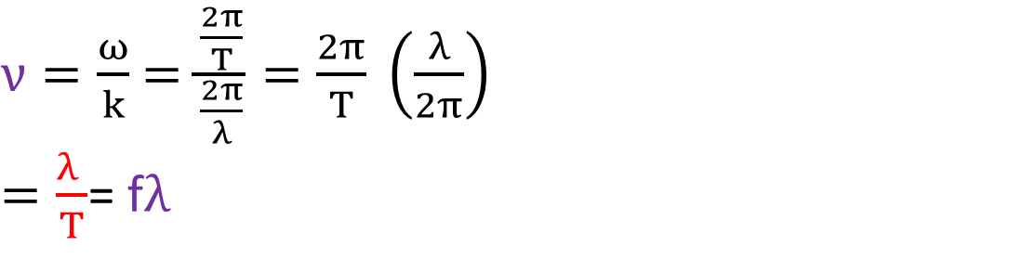
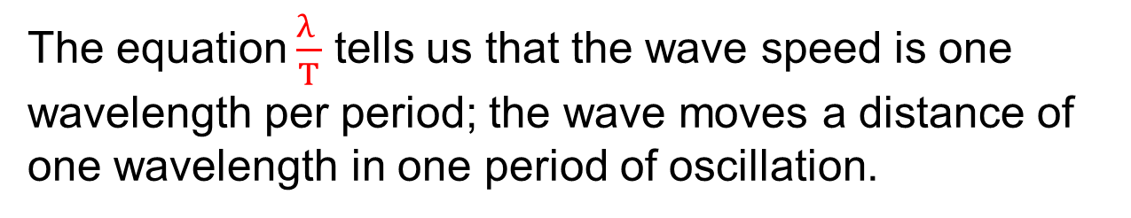
The plus sign verifies that the wave is indeed moving in the positive direction of x.
$ν=\frac{ω}{k}$ $=\frac{\frac{2π}{T}}{\frac{2π}{λ}}=\frac{2π}{T} \left(\frac{λ}{2π}\right)$
$=\frac{λ }{T}$= f$λ$
The equation $\frac{λ }{T}$ tells us that the wave speed is one wavelength per period; the wave moves a distance of one wavelength in one period of oscillation.

Slide 11






$$v=−\frac{ω}{k}$$
The equation of transverse travelling wave moving in -ve x-axis is,
$$y=y_{m}\sin{(kx+ωt)}$$
Here, $kx+ωt=$constant
$$k\frac{dx}{dt}+ω=0$$
$$kv=−ω$$
$$∴v=−\frac{ω}{k}$$

Slide 12
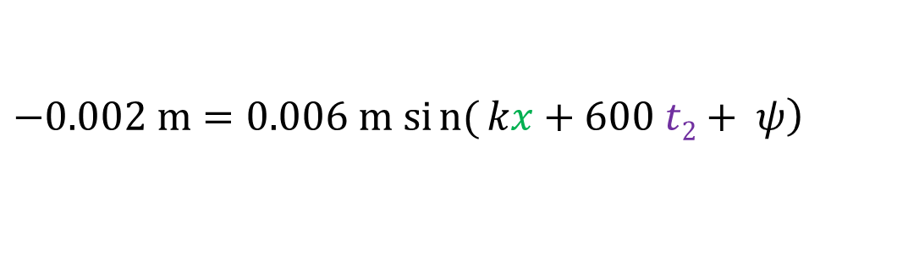
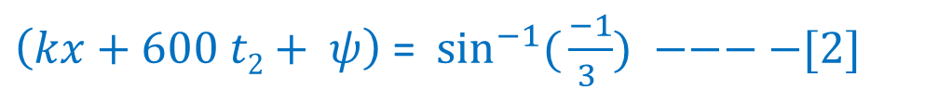
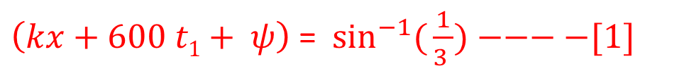
1. If a wave y(x, t) = (6.0 mm) sin(kx + (600 rad/s)t + φ) travels along a string, how much time does any given point on the string take to move between displacements y = + 2.0 mm and y = - 2.0 mm?
$$0.002 m=0.006 m \sin\left(kx+600 t1+ ψ\right)$$
$\left(kx+600 t1+ ψ\right)$= $\sin^{−1}({\frac{1}{3 })−−−−[1]}$
$$\left.−0.002 m=0.006 m sin{(}kx+600 t2+ ψ\right)$$
$\left(kx+600 t2+ ψ\right)$= $\sin^{−1}({\frac{−1}{3 }) −−−−[2]}$

Slide 13


$(kx+600 t1+ ψ) −(kx+600 t2+ ψ)=\sin^{−1}({\frac{1}{3 })} −$ $\sin^{−1}({\frac{−1}{3 })}$
$$600 (t1− t2)=2\sin^{−1}({\frac{1}{3 })}$$
$t1− t2$ = 0.001133 s

Slide 14
5. A sinusoidal wave travels along a string. The time for a particular point to move from maximum displacement to zero is 0.170 s. What are (a) the period and (b) frequency? (c) The wavelength is 1.40 m; what is the wave speed?
T = 4 (0.170) s = 0.680 s (b) f =1/T = (1/ 0.680) Hz = 1.47 Hz (c) λ = 1.40 m v = fλ = 1.47 (1.40) m/s = 2.06 m/s

